Slide 1

Fleet Monitoring System
sdmay18-18
http://sdmay18-18.sd.ece.iastate.edu/
Venecia Alvarez, Kendall Berner, Matthew Fuhrmann,
William Fuhrmann, Anthony Guss, Tyler Hartsock
Client/Advisor: Lotfi Ben-Othmane

Slide 2
Problem Statement
Problem:
Managing large fleets of vehicles is costly and time-consuming
Fleet managers don’t have information to make improvements
Solution:
Vehicle location data and internal data gathered from on-board Raspberry Pi 3
Server processes vehicle data, provides data to fleet manager website
Allow a fleet manager to see real time data of vehicles

Slide 3
Market Survey
Other Fleet Management Applications:
OBD II or Mobile App
Live tracking, statistics, vehicle data
Live map of fleet
Our Application vs Rest of Market:
Minimize driver interaction
Useful interpretations of vehicle internal data
Less focus on fleet administration, more on fleet monitoring
Notes:
-Some apps use the OBD II port to collect data, some have drivers input data manually
-Some apps require drivers to input the data... ours collects data handsfree
-Instead of just listing data values, we display data in nice charts and graphs
-Providing managers with all the necessary information, but not telling them how to run their business

Slide 4
Functional Requirements
The product shall:
Gather data from a vehicle’s OBD-II (On-Board Diagnostics) port
Transmit data from the vehicle to the server
Process raw data from the vehicle on the server
Record vehicle data into a database
Display a map with a location of all vehicles in the fleet
Display live data for a certain vehicle (speed, engine temperature)
Allow managers to register or remove vehicles that belong to a particular fleet
Allow managers to customize the data being displayed to them

Slide 5
Non-Functional Requirements
The product shall:
Only allow managers to view fleet data on the website
Only allow managers to view vehicles in their fleet

Slide 6
Constraints
Have the server side code made in Node.js
Utilize Google Cloud services

Slide 7
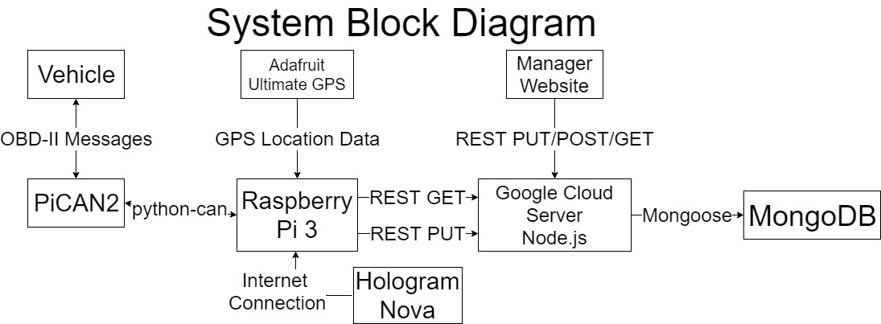
Notes:
-Raspberry Pi uses a PiCAN2 device to interface with the OBD-II port
-The Raspberry Pi gathers location data using an Adafruit Ultimate GPS
-server implemented using Node.js
-The API is implemented using GET, POST, PUT and DELETE API calls
-server maintains a Mongo database through the use of Mongoose
-main web page displays a live map tracking the locations of all vehicles in the
fleet in real time

Slide 8
Detailed Design - Front End
Emphasis on visualizing data on the main page
Other pages
Login
Register
Edit fleet
Edit view
Technologies Used
AngularJS
Chart.js
Google Maps API
Bootstrap
Notes:
Emphasize single page application
Briefly describe pages
We utilized AngularJS services to extract functionalities into organized modules. Services include: mapService, chartService, and sessionService. Each service is responsible for specific functionality and is easily reusable and extendable.

Slide 9
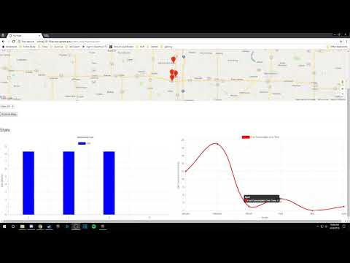

Slide 10
Detailed Design - Server
Technologies Used: NodeJS, MongoDB, Mongoose, Bcrypt.js
RESTful API
PID Processing
Swagger Documentation
Hosted on Google Cloud Compute Engine

Slide 11
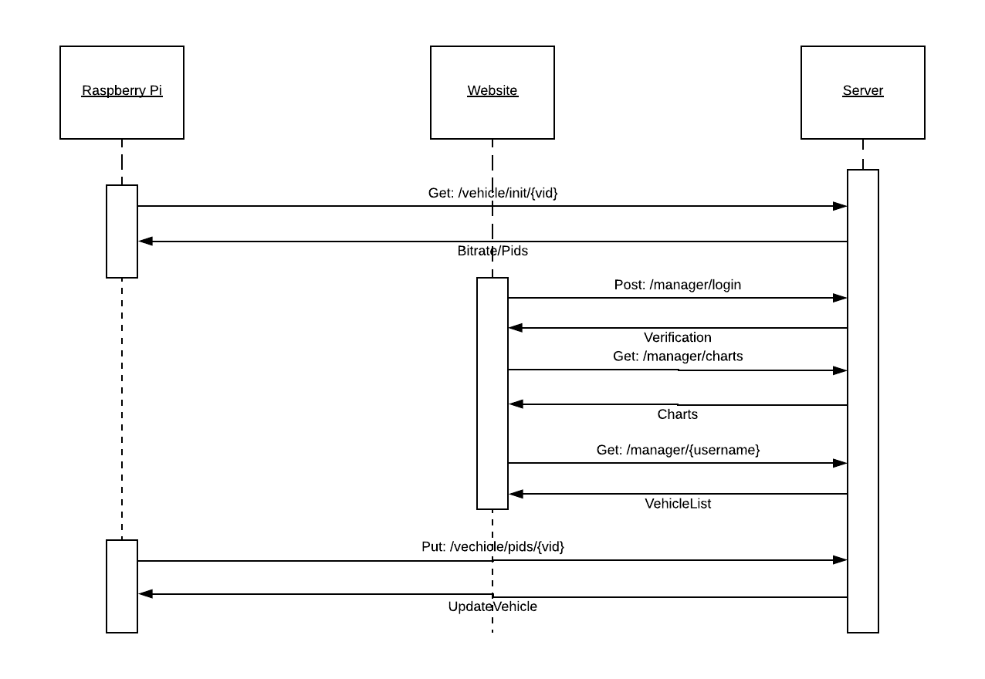
Server Sequence Diagram

Slide 12
Detailed Design - Raspberry Pi
Hardware Used: PiCAN2, Adafruit Ultimate GPS, Hologram Nova
Technologies Used: Python, gpsd, gpsd-clients, python-gps, python-can, requests
Modules:
fleet_monitoring_pi: Startup the application, poll configuration in a thread
can_interface: Use python-can to interact with OBD-II port using threads
Gps_interface: Use python-gps to interact with gpsd reports using a thread
api_engine: Singleton, handle API calls
config: Singleton, handle configuration storage based on polling, startup arguments

Slide 13
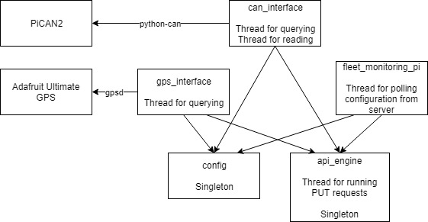

Slide 14
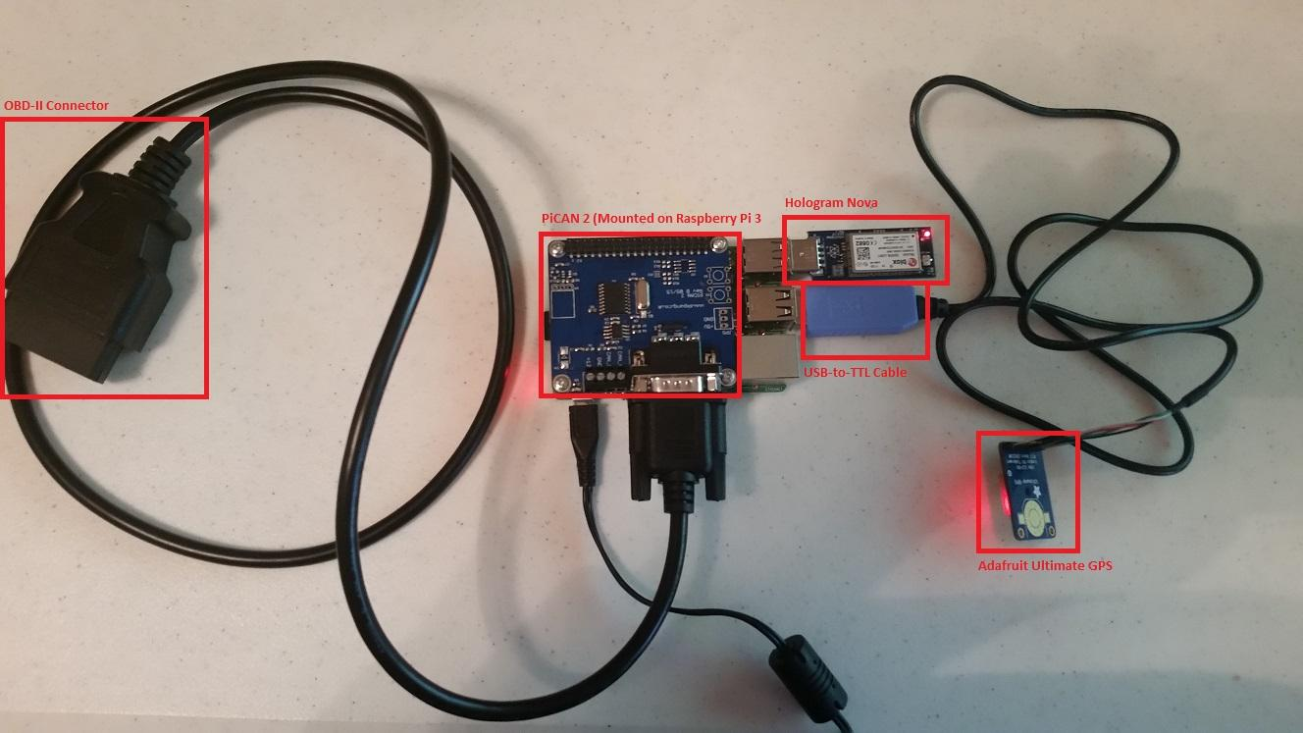

Slide 15
Testing Plan
Front End: UwAmp/XAmpp for local testing, confirm database updates show up live on the website
Raspberry Pi: Verify hardware functionality by running Python modules individually, verify that api_engine results are correct by comparing with Postman calls. OBD-II testing done by OBD-II simulator and rented U-Haul van, as well as overall system testing using the real vehicle
Server: Automated API Testing Using Postman, Unit Testing for PID processing

Slide 16
Testing Results
GPS module tested in operating vehicle - successful
OBD-II module tested in operating vehicle - successful
Raspberry Pi data sent from operating vehicle using Hologram Nova - successful
Website tested to confirm live update of location and statistics - successful
Server tested using Postman runners for all API calls - successful

Slide 17
Alternative Designs
Java Spring Microservices
Android Microcontroller
R Data Analytics
Google Roads API

Slide 18
Questions?

